Slide 1
Unit-2
Organisation Structure And Functions

Slide 2
Concepts
Organisation is a social unit of people, systematically structured and managed to meet a need or to pursue collective goals on a continuing basis.

Slide 3
Concepts
AUTHORITY
RESPONSIBILITY
DELEGATION
ACCOUNTABILITY

Slide 4
Organisation structure
Organizational structure refers to the way in which a group is formed, its lines of communication, and its means for channeling authority and making decisions.

Slide 5
CHARACTERISTICS OF AN ORGANIZATIONAL STRUCTURE
DIVISION OF LABOR/WORK
CHAIN OF COMMAND
UNITY OF COMMAND
SPAN OF CONTROL
AUTHORITY

Slide 6
Importance of organisational structure
It enables members to know what their responsibilities.
Minimal duplication of effort or conflict.
Impacts effectiveness and efficiency.
Promotes teamwork.
Improves communication.

Slide 7
Pre-bureaucratic,
bureaucratic
post-bureaucratic,
Functional
virtual

Slide 8
Organizational Structure Types
Bureaucratic Structures
Three types of bureaucratic structures
Pre-bureaucratic structures-only one key decision maker.

Slide 9
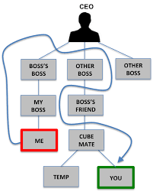
Pre-bureaucratic structures

Slide 10
Bureaucratic structures-
In its simplest form, a tall structure results in one long chain of command similar to the military.

Slide 11
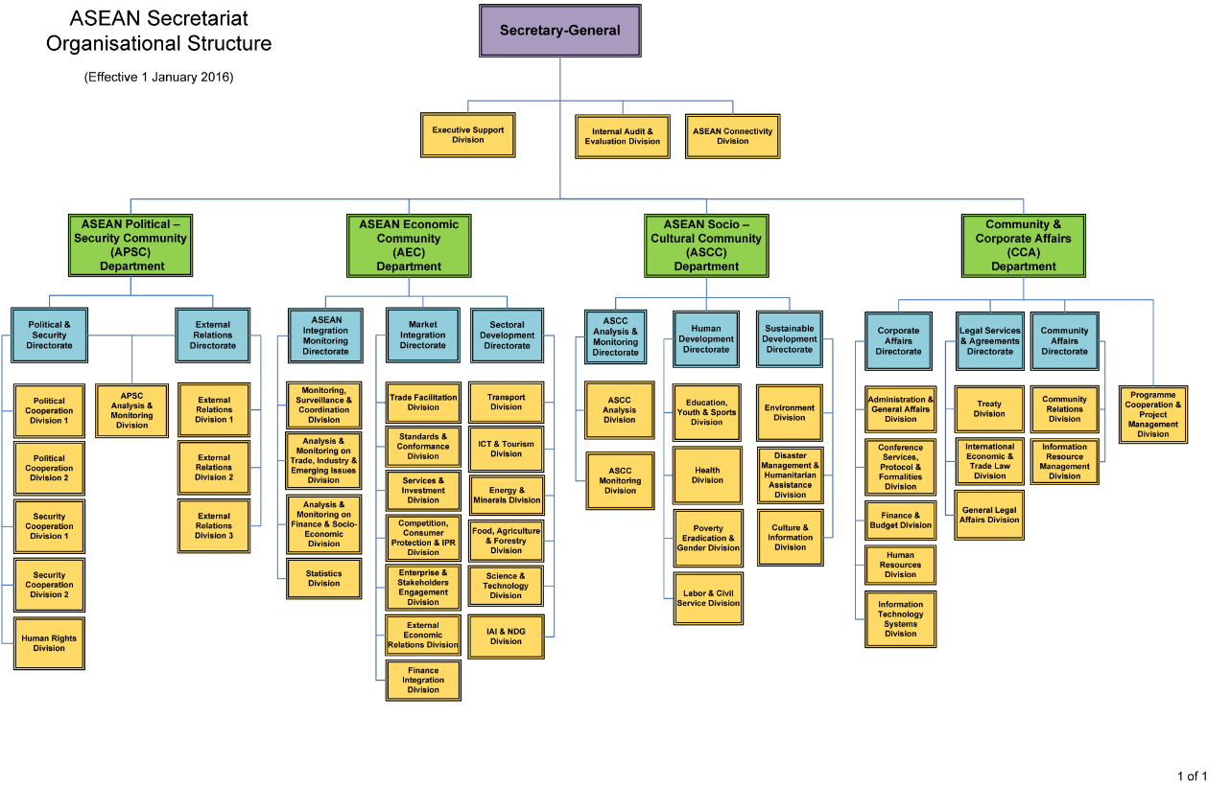
Bureaucratic structures-

Slide 12
ADVANTAGES:
The quality of performance will improve due to close supervision.
Discipline will improve.
Superior - Subordinate relations will improve.
Control and Supervision will become easy and convenient.
The manager gets more time to plan and organise the future activities.
The efforts of subordinates can be easily coordinated.
Tall Organisation encourages development of staff.
There is mutual trust between superior and subordinates

Slide 13
DISADVANTAGES:
Tall Organisation creates many levels of management.
There are many delays and distortion in communication.
Decisions and actions are delayed.
It is very costly because there are many managers. The managers are paid high salaries.
It is difficult to coordinate the activities of different levels.
There is strict supervision. So the subordinates do not have any freedom.
Tall Organisation is not suitable for routine and standardised jobs.
Here, managers may became more dominating.

Slide 14
Post-bureaucratic Structures
The organizations that follow post-bureaucratic structures still inherit the strict hierarchies, but open to more modern ideas and methodologies. They follow techniques such as total quality management (TQM), culture management, etc.

Slide 15
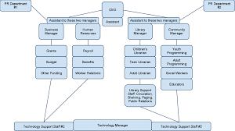
Post-bureaucratic Structures

Slide 16
Functional Structure
The organization is divided into segments based on the functions when managing. This allows the organization to enhance the efficiencies of these functional groups. As an example, take a software company.
Software engineers will only staff the entire software development department. This way, management of this functional group becomes easy and effective.

Slide 17
Virtual organization
uses information and communication technologies to replace or augment some aspect of the organization.
People are virtually organized primarily interact by electronic means.
eg: many customer help desks link customers and consultants together via telephone or the Internet

Slide 18
Human Resource Planning
Meaning – Assessment of Human Resource Requirements & also the time & stages of requirement.
Right person ---At Right place ---At Right time.
Definition – HRP is defined as the process by which management determines how an org should move from its current manpower position to its desired manpower position.

Slide 19
Objectives of HRP
To ensure optimum use of existing HR.
To forecast future requirement for HR.
To provide control measures to ensure that necessary HR are available as and when required.
To asses the surplus and shortage of HR. (Downsizing).
To anticipate the impact of technology on jobs and HR.

Slide 20
Objectives of HRP – Contd.
To determine the level of Recruitment and Training.
To estimate the cost of HR and Housing needs of employees. (Or HRA).
To provide the basis of MDP.
To meet the needs of expansion and diversification programmes.

Slide 21
Importance of HRP
Future Personnel needs
Creating highly talented personnel
International Strategies
Foundation of personnel function
Resistance to change and move

Slide 22
HRP Process
Environment
Org objectives & policies
HR Need Forecast
HR Supply Forecast
HR Programming
HRP Implementation
Control & Evaluation
Surplus
Shortage

Slide 23
HRP Process (Contd.)
Environmental Scanning - :
Economic factors
Technological Changes
Demographic changes
Political and legislative issues
Social concerns

Slide 24
HRP Process (Contd.)
Org objectives and policies-:
HR plans need to be based on org objectives, this implies that the objectives of the HR plan must be derived from Org objectives.

Slide 25
HRP Process (Contd.)
HR Demand forecast-:
The process of estimating the future quantity and quality of people required.
The basis of forecast will be annual budget and long term corporate plans.
Demand forecasting must consider (Budget constraints, employee separations, production level) and external (Competition, laws, change in technology).

Slide 26
HRP Process (Contd.)
Demand forecasting techniques are-:
Managerial judgment
Ratio trend analysis
Delphi technique
Regression analysis
HR Supply forecasting-:
Supply forecasting measures the number of people likely to be available from within and outside an org.

Slide 27
HRP Process (contd.)
HR Programming-:
Once the Org’s HR Demand and Supply are forecast, the two must be reconciled or balanced in order that vacancies can be filled by the right employee at the right time.
HR Plan Implementation-:
Implementation requires converting an HR plans into action. (Recruitment, Training, Succession plan etc.)

Slide 28
HRP Process (contd.)
Control and Evaluation -:
Critical to have proper control and regular checks to know the achievements of HRP.
Surplus Shortage
Restricted hiring R & S
VRS, Lay off

